Slide 1

ActiveData
https://activedata.allizom.org
Kyle Lahnakoski
klahnakoski@mozilla.com
Product Integrity
December 2017

Slide 2

Another lightning talk on…
ActiveData
https://activedata.allizom.org
Kyle Lahnakoski
klahnakoski@mozilla.com
Product Integrity
December 2017

Slide 3


What Data?
Jobs
Test Results
Buildbot
ActiveData

Slide 4

What Data?
Tasks
Test Results
Coverage
TaskCluster
ActiveData

Slide 5




What Data?
Jobs
Treeherder
Perf Details
Perfherder
changesets
hg.mozilla.org
Test results
ActiveData

Slide 6
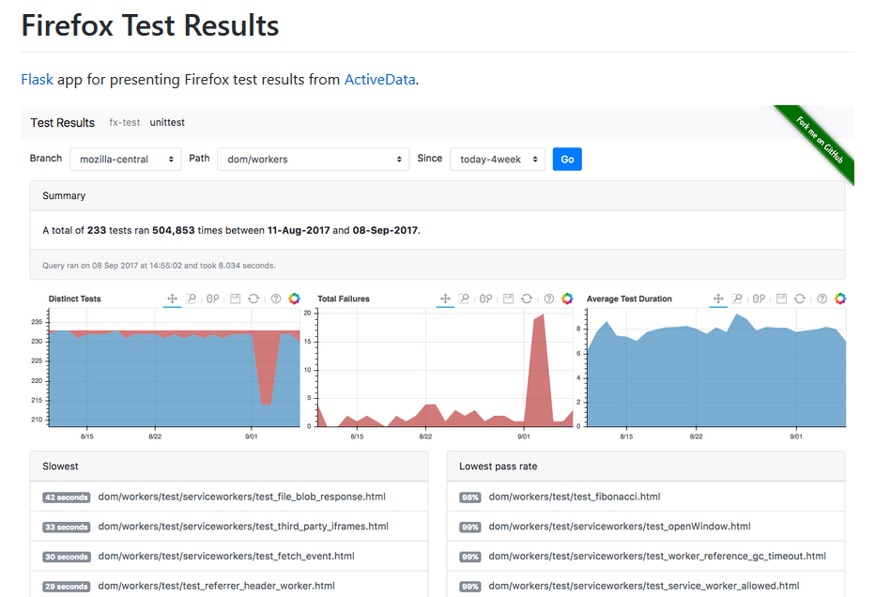

Slide 7
Data, so what!?

Slide 8
Example: Find Artifacts
{
"AUTHORS": [
"mozilla.org",
"Licensing"
],
"accessible/aom/AccessibleNode.cpp": [
"Core",
"Disability Access APIs"
],
"accessible/aom/AccessibleNode.h": [
"Core",
"Disability Access APIs"
],
"accessible/aom/moz.build": [
"Core",
"Disability Access APIs"
],
Bugzilla job generates components.json.gz

Slide 9
Example: Find Artifacts
{
"select":["url","action.start_time"],
"from":"task.task.artifacts",
"where":{"and":[
{"gte":{"action.start_time":{"date":"today"}}},
{"eq":{"name":"public/components.json.gz"}}
]},
"sort":{"action.start_time":"desc"}
"limit":1
}

Slide 10
Example: Find Artifacts
{
"select":["url","action.start_time"],
"from":"task.task.artifacts",
"where":{"and":[
{"gte":{"action.start_time":{"date":"today"}}},
{"eq":{"name":"public/components.json.gz"}}
]},
"sort":{"action.start_time":"desc"}
}
SELECT
url,
"action.start_time"
FROM
"task.task.artifacts"
WHERE
"action.start_time" >= TODAY() AND
name = 'public/components.json.gz'
SORT BY
"action.start_time" DESC
LIMIT
1

Slide 11
Example: Find Artifacts
{
"select":["url","action.start_time"],
"from":"task.task.artifacts",
"where":{"and":[
{"gte":{"action.start_time":{"date":"today"}}},
{"eq":{"name":"public/components.json.gz"}}
]},
"sort":{"action.start_time":"desc"}
}
{"data":{
"url":["http://queue.taskcluster.net/v1/task/KSuWaly5QVmDi5u404OJyA/artifacts/public/components.json.gz"],
"action.start_time":[1513181228.52]
}}

Slide 12
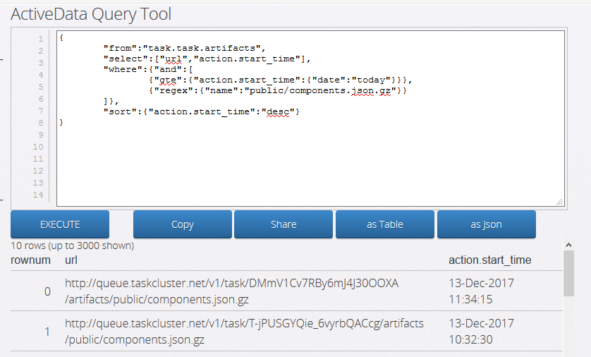
Example: Find Artifacts

Slide 13
Example: Test Task Times
{
"from":"task",
"select":[
{"aggregate":"count"},
{
"name":"median duration (seconds)",
"value":"action.duration",
"aggregate":"median"
}
],
"edges":[
{"name":"chunk","value":["run.suite.name","run.chunk"]},
{
"value":"action.start_time",
"domain":{
"type":"time",
"min":"today-month",
"max":"today",
"interval":"day"
}
}
],
"where":{"and":[
{"eq":{"repo.branch.name":"mozilla-inbound"}},
{"eq":{"treeherder.jobKind":"test"}},
{"eq":{"build.type":"opt"}},
{"eq":{"build.platform":"linux64"}},
{"gte":{"action.start_time":{"date":"today-month"}}}
]},
"limit":1000
}

Slide 14
Example: Test Task Times
Run the query
Cut-and-paste to a spreadsheet
Convert to pivot table
Normalize the run times over time to 1
Chart

Slide 15
Well, that was painful!

Slide 16
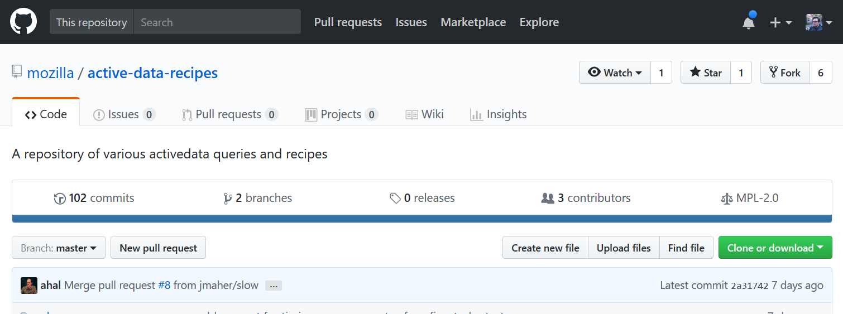
Recipes!

Slide 17
Recipes!
Canned queries, with parameters
Adds post-processing
Allows cross-referencing

Slide 18
Recipes!
Microsoft Windows [Version 10.0.14393]
(c) 2016 Microsoft Corporation. All rights reserved.
C:\Users\kyle>pip install active-data-recipes
Collecting active-data-recipes
...
C:\Users\kyle>adr --list
backout_rate
code_coverage
code_coverage_by_suite
files_with_coverage
hours_on_try
inspect
raw_coverage
task_durations
try_usage
try_users

Slide 19
Recipes!
C:\Users\kyle>adr -v task_durations
┌──────────────────────────────────────────────────────────┬───────┬───────────────┬─────────────┐
│ Task │ Count │ Average Hours │ Total Hours │
├──────────────────────────────────────────────────────────┼───────┼───────────────┼─────────────┤
│ test-linux64-nightly/opt-mochitest-valgrind-14 │ 14 │ 4.02 │ 56 │
│ test-linux64-nightly/opt-mochitest-valgrind-6 │ 14 │ 4.02 │ 56 │
│ test-linux64/opt-mochitest-valgrind-14 │ 12 │ 4.01 │ 48 │
│ test-linux64/opt-mochitest-valgrind-6 │ 12 │ 4.01 │ 48 │
│ test-linux64-nightly/opt-mochitest-valgrind-1 │ 14 │ 2.68 │ 38 │
│ test-linux64/opt-mochitest-valgrind-1 │ 12 │ 2.5 │ 30 │
│ spidermonkey-sm-compacting-win32/debug │ 97 │ 2.3 │ 223 │
│ test-linux64/opt-mochitest-valgrind-9 │ 11 │ 2.27 │ 25 │
│ test-linux64-nightly/opt-mochitest-valgrind-40 │ 14 │ 2.25 │ 32 │
│ spidermonkey-sm-plain-win32/debug │ 95 │ 2.1 │ 200 │
│ test-linux64/opt-mochitest-valgrind-40 │ 12 │ 2.08 │ 25 │
│ test-windows10-64-ccov/debug-web-platform-tests-12 │ 40 │ 1.92 │ 77 │
│ test-linux64-nightly/opt-mochitest-valgrind-9 │ 13 │ 1.88 │ 24 │
│ test-linux64-nightly/opt-mochitest-valgrind-39 │ 14 │ 1.76 │ 25 │
│ test-windows10-64-ccov/debug-web-platform-tests-11 │ 41 │ 1.71 │ 70 │
│ test-windows10-64-nightly/opt-browser-instrumentation │ 14 │ 1.69 │ 24 │
│ build-win64-nightly/opt │ 15 │ 1.67 │ 25 │
│ test-windows10-64-ccov/debug-web-platform-tests-8 │ 41 │ 1.64 │ 67 │
│ test-linux64/opt-mochitest-valgrind-39 │ 12 │ 1.61 │ 19 │
│ build-win32-nightly/opt │ 16 │ 1.56 │ 25 │
│ build-win64/pgo │ 476 │ 1.5 │ 714 │
│ test-windows10-64-ccov/debug-web-platform-tests-10 │ 41 │ 1.48 │ 61 │
│ test-windows10-64-ccov/debug-web-platform-tests-9 │ 40 │ 1.44 │ 58 │
│ build-win32/pgo │ 471 │ 1.41 │ 664 │
│ test-linux64-ccov/opt-web-platform-tests-8 │ 39 │ 1.4 │ 55 │

Slide 20
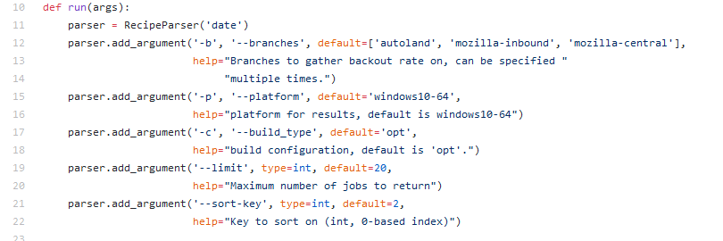
Recipes!

Slide 21
Steps

Slide 22
Steps
Ask me, Kyle Lahnakoski

Slide 23
Steps
Ask me, Kyle Lahnakoski
See #1

Slide 24
Done

Slide 25
ActiveData
https://activedata.allizom.org
Kyle Lahnakoski
klahnakoski@mozilla.com
Product Integrity
December 2017

